Slide 1



Garbage Classification

Slide 2

Learning Objectives
Understand the problem domain ie. Garbage Classification and its Real World Importance e.g recycling, waste management etc.
Learn the basic of Computer Vision and Convolutional Neural Networks(CNNs).
Implement Model Building with Transfer Learning.
Develop skills in Model learning and Optimization.
Develops practical Deployment Skills.
Strengthen Soft Skills and Project Skills by building responsible AI Awareness.
GOAL
Source :
www.freepik.com/

Slide 3
Tools and Technology used
Programming Languages
Python – The dominant language for Machine Learning Projects.
Development Environments
VS Code
Jupyter Notebook
Libraries/Frameworks
Numpy- Numerical computations & arrays.
Matplotlib- Data plotting & visualisation.
Seaborn- Statistical visualisation.
Tensorflow/keras-Deep learning, building, training & deploying.
MobileNetv3Small- Pretrained model for transfer learning.
Scikit- learn- Class weights & evaluation matrics.
Gradio- Interactive web apps for ML models.
Version Control
Git
Github

Slide 4
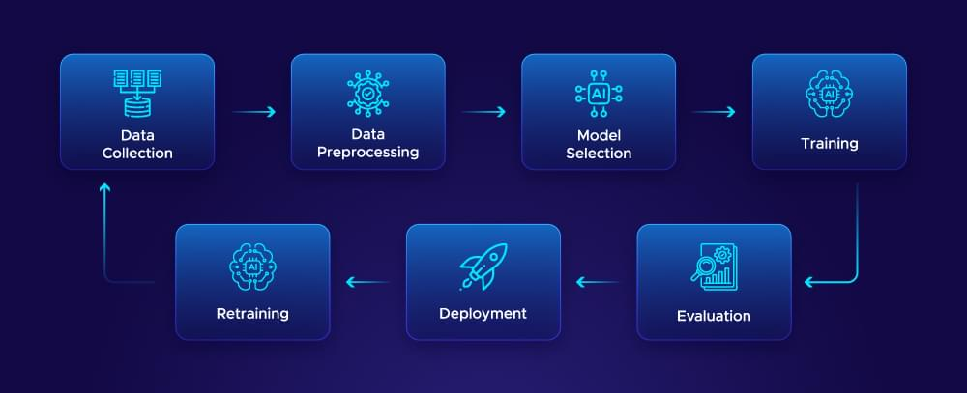
Methodology
Explore and Understand the dataset
Load the image dataset using tools (image_dataset_from_directory).
Visualize sample images from each class.
Check the number of class to ensure balance
Understand image dimensions, color channels, and class labels.

Slide 5
Methodology
Data Preprocessing/ Preparation
Resize and rescale images.
Apply data augmentation (e.g. RandomFlip, RandomRotation) to improve generalization.
Normalize images (using preprocess_input if using pretrained models like MobileNetV3Small).
Model Selection
Choose a model: Custom CNN or transfer Learning(e.g MobileNetV3Small).
Decide whether to use pre-trained weights(e.g ImageNet).
Define whether layers should be trainable or frozen during initial training.
Model Training
Build the model architecture using Sequential or Functional API.
Compile the model with loss function (sparse_categorical_crossentr optimizer (e.g Adam), and evaluation metrics (accuracy).

Slide 6
Methodology
Model Tuning and Optimization
Tune hyperparameters: Learning rate, batch size, no. of layers, dropout rate.
Use callbacks: EarlyStopping.
Optionally perform fine-tuning on pre-trained models by unfreezing some layers.
Train the model using .fit() with appropriate epochs, batch_size, and callbacks.
Model Evaluation
Plot training and validation accuracy/loss curves.
Evaluate model performance on validation or test set.
Use metrics like Confusion Matrix & Classification Report.
Final testing and save the model.
Evaluate the final model on the unseen test dataset.
Model Deployment
Create a web interface using Gradio.
Load the saved model and preprocess input images before prediction.

Slide 7
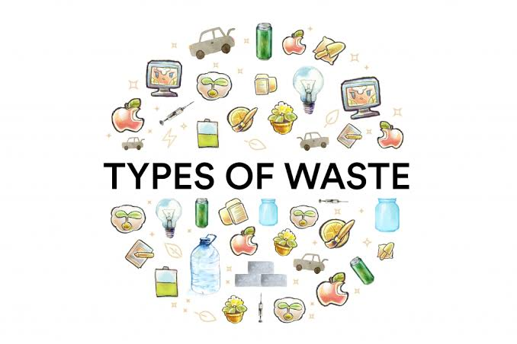
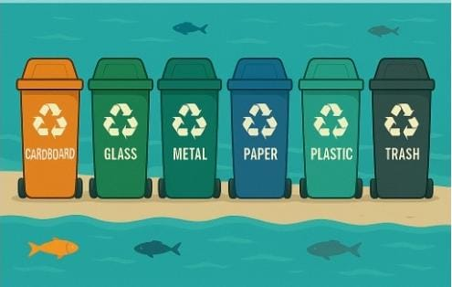
Problem Statement:
To develop an accurate and efficient garbage classification model using MobileNetV3Small and transfer learning for automated waste sorting.
Description :
In this project, we aim to develop a sophisticated garbage classification system leveraging the MobileNetV3Small architecture. Our primary dataset serves as a foundation for building models that can eventually automate waste segregation, a critical step in optimizing recycling and waste management, ultimately aiding in environment conservation.

Slide 8
Solution:
Dataset Preparation:
Use an existing dataset (e.g kaggle dataset)
Preprocess images by resizing and normalizing it.
Split it into training, validation, and test sets.
Model Architecture using MobileNetV3small:
Load MobileNetV3Small without the top layer (include_top=False).
Use weights=‘imagenet’ for pretrained learing.
Freeze early layers to retain pretrained features.
Handling class Imbalance:
Use class_weight argument in model.fit or use data augmentation to balance samples visually.
Training Strategy:
Compile with Adam optimizer and categorical crossentropy loss & use EarlyStopping for optimal training.

Slide 9
Solution:
Evaluation:
Evaluate using Accuracy, Precision, Recall, F1-score
Use Confusion Matrix (visualize with seaborn) & Classification Report (sklearn.metrics).
Test the model on real waste images.
Deployment:
Build a web interface using Gradio.

Slide 10
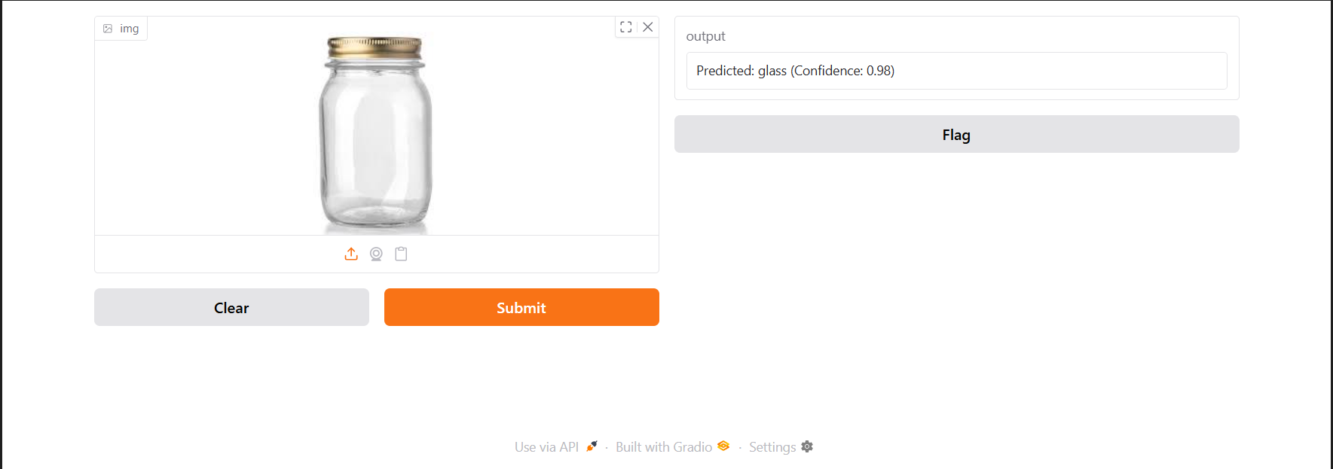
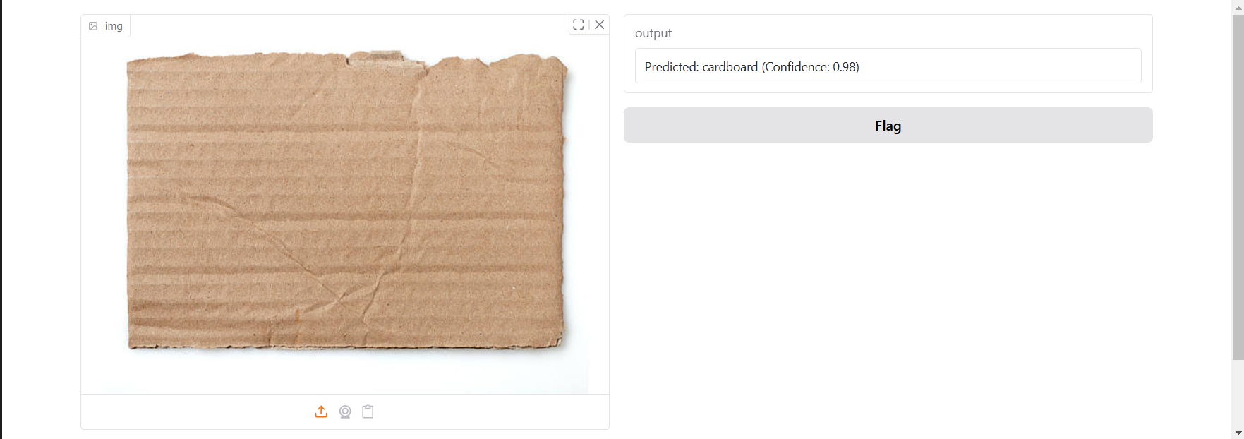
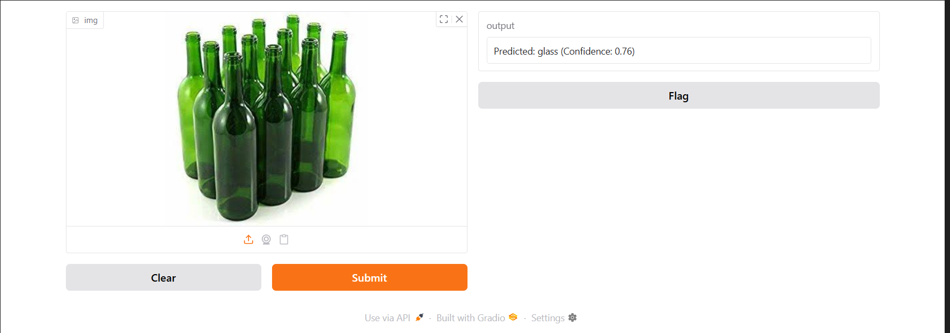
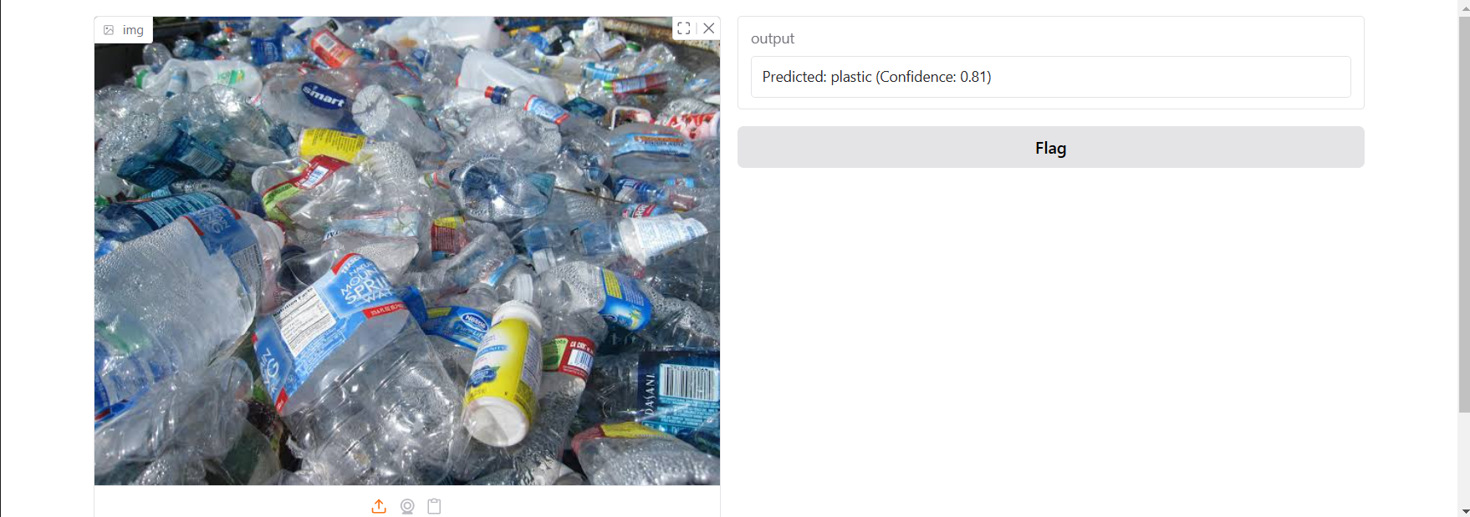
Screenshot of Output:

Slide 11
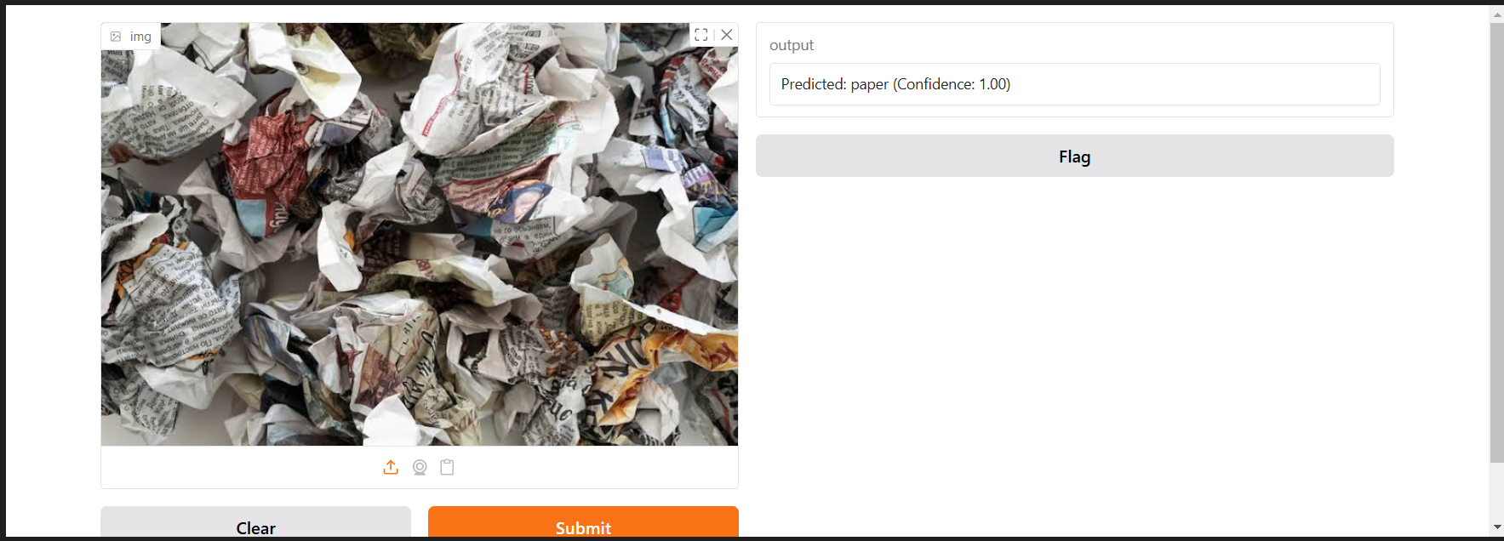
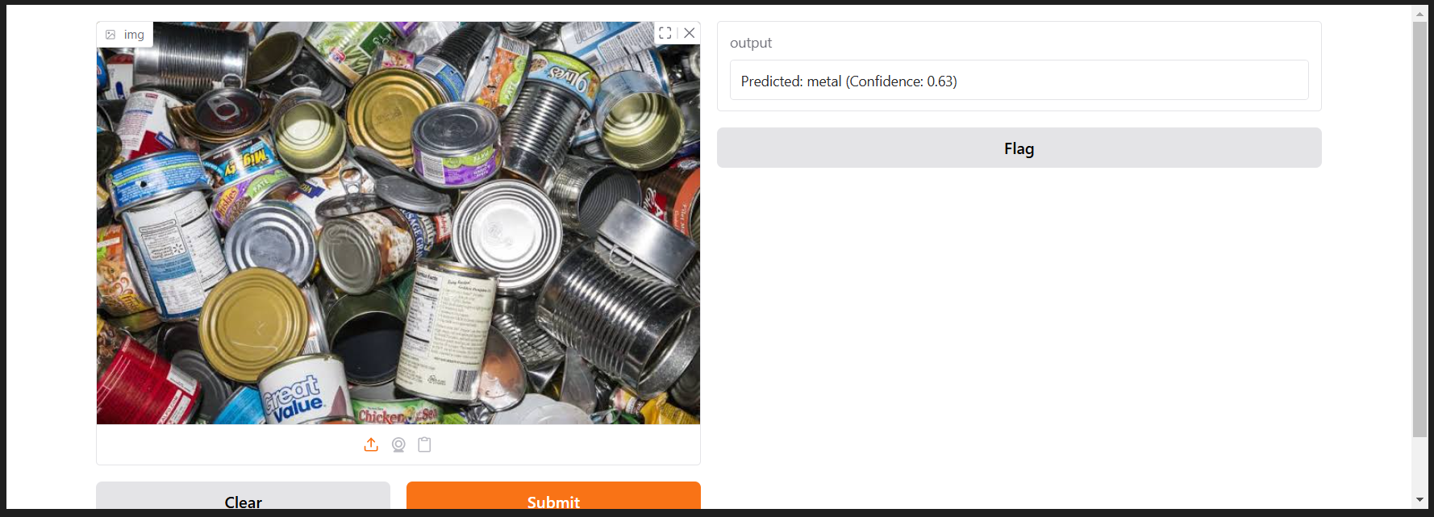
Screenshot of Output:

Slide 12
Conclusion:
The image classification model demonstrates strong accuracy in identifying objects, leveraging deep learning to refine predictions effectively.
Its robust performance ensures reliable classification, making it a valuable tool for various applications.
It also helps in aiding in environmental conservation.
Git Link:
https://github.com/Shrabani-2005/week3GarbageClassification.git
THANKYOU

